Slide 1
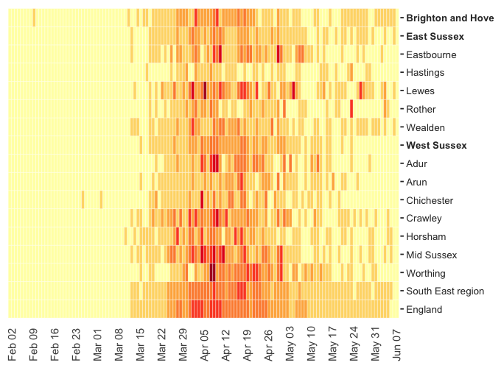

Summary of new confirmed Covid-19 cases per 100,000 population (all ages); 30 January to 7 June
Data are back dated and revised such that every lab-confirmed case is attributed to the date at which the specimen was taken, which means the outbreak starts on different dates for different areas. The first specimens for a confirmed Covid-19 infection were taken on January 30th 2020.
The latest available data in this analysis are for Sun 7 June. However, as data for recent days are likely to change significantly, only data up to Tue 2 June should be treated as complete. The cumulative cases are taken from the most recently available date, although number of confirmed cases in a single day (a proxy for new cases) is taken from six days prior (latest complete date).
Name | Total confirmed cases so far | Total cases per 100,000 population | Confirmed cases swabbed on most recent complete day | Most recent complete 7 days (27-May-2-June) | Previous 7 days (20-May-26-May) | Rate of growth in cases | New cases per 100,000 population by day
Brighton and Hove | 468 | 161 | 5 | 107.2 days | 103.1 days | Slowing
East Sussex | 734 | 132 | 8 | 208.8 days | 82.7 days | Slowing
Eastbourne | 152 | 147 | 0 | 588.1 days | 323.1 days | Slowing
Hastings | 55 | 59 | 0 | 352.6 days | 55.1 days | Slowing
Lewes | 208 | 202 | 3 | 146.1 days | 66.6 days | Slowing
Rother | 99 | 103 | 3 | 208.1 days | 50.7 days | Slowing
Wealden | 220 | 137 | 2 | 181.6 days | 90.6 days | Slowing
West Sussex | 1,337 | 156 | 1 | 585.5 days | 335.4 days | Slowing
Adur | 99 | 155 | 0 | 637.2 days | 378.5 days | Slowing
Arun | 164 | 103 | 0 | - | 528.9 days
Chichester | 142 | 118 | 0 | - | -
Crawley | 211 | 188 | 0 | 677.7 days | 210.6 days | Slowing
Horsham | 214 | 150 | 0 | 313.0 days | 401.7 days | Speeding up
Mid Sussex | 290 | 194 | 1 | 507.3 days | 275.6 days | Slowing
Worthing | 217 | 197 | 0 | 381.2 days | 258.4 days | Slowing
South East region | 22,013 | 241 | 79 | 290.9 days | 185.9 days | Slowing
England | 155,000 | 277 | 465 | 268.2 days | 194.5 days | Slowing
*There were no new cases reported in Arun or Chichester in the most recent complete days and as such the doubling time is not calculated.

Slide 2
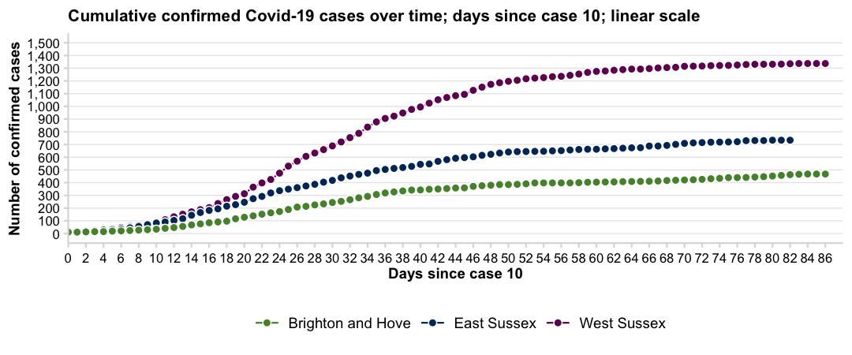
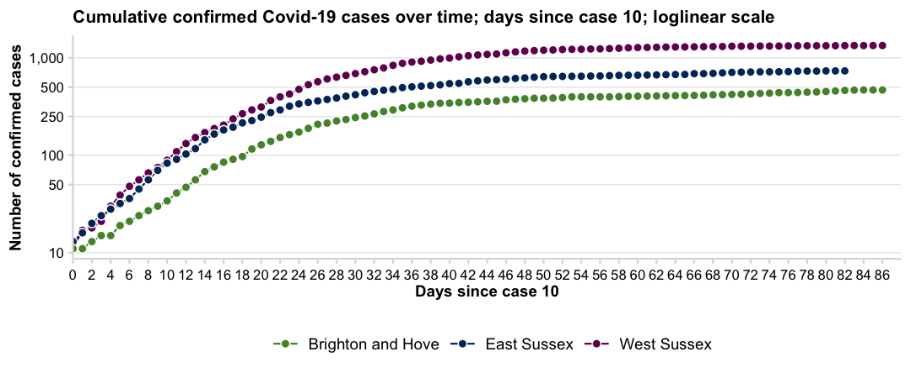
As some areas record their first few confirmed cases on different days, the x axis (along the bottom from left to right) has been redrawn to count the number of days since case number 10.
Starting on case number 10, rather than case number 1, means that the trajectories are more established and potentially showing transmission within an area as opposed to single cases coming into the area.
In addition, on the bottom plot, the y (vertical) axis has been redrawn to show the cumulative number of confirmed cases on a logarithmic scale to highlight changes in growth (speeding up or slowing down) of infections.
A straight line with a steep slope indicates that the diagnosed cases will double in a short period of time whereas a line with a flatter slope suggests that the cases are not growing as quickly and will take much longer to double.
As at 07 Jun, East Sussex has recorded 734 confirmed Covid-19 cases. This is 28.9% of confirmed cases in Sussex to date.

Slide 3
Deaths – ONS Data – UPDATE
ONS have released (as of 07/06/2020) weekly deaths broken down to local authority level, of all deaths and Covid-19 deaths. This dataset will be published every week and includes deaths outside of hospital.
Weekly deaths are provided for 2020 and from March 31 Covid-19 deaths relate to any death involving coronavirus (Covid-19), based on any mention of Covid-19 on the death certificate.
Two sets of tables are available, one set based on the date of registration and one set based on date of occurrence of death. There can be a time lag between a death taking place and the subsequent registration. The tables presented here include deaths that occurred up to 29th May but were registered up to 6th June. This means there may be some revisions to the dataset for recent weeks, notably in relation to deaths by date of occurrence as registrations are subsequently made. These slides relate to date of occurrence not registration.
In the main data are provided at upper tier Local Authority level (given small numbers, at present, below this in terms of Covid-19), ONS release data at lower tier authority and where appropriate these figures are included.
Note: only deaths (whether Covid-19 or all cause) by place (setting of death) by local authority of usual residence are published on a weekly basis. We do not currently have weekly data on age, gender, or underlying condition at this geographical level.
However, age-standardised data on cumulative deaths occurring between 01/03/2020 and 17/04/2020 by sex at local level are presented here and will be updated as soon as more recent data becomes available. It is anticipated that a new release of this age-standardised data will be published on Friday 12th June.
Mortality data for deaths occurring in hospitals are also available and these are published by hospital trust, with data being updated daily.
Jacqueline.clay@westsussex.gov.uk
0330 222 8684
Please call if you have queries about the data in the slides

Slide 4
Deaths – ONS Data – Overall Table – Deaths by Date of Occurrence
All cause deaths | Week ending
 | w/e 3rd Jan | w/e 10th Jan | w/e 17th Jan | w/e 24th Jan | w/e 31st Jan | w/e 7th Feb | w/e 14th Feb | w/e 21st Feb | w/e 28th Feb | w/e 6th Mar | w/e 13th Mar | w/e 20th Mar | w/e 27th Mar | w/e 3rd Apr | w/e 10th Apr | w/e 17th Apr | w/e 24th Apr | w/e 1st May | w/e 8th May | w/e 15th May | w/e 22nd May | w/e 29th May
Brighton and Hove
East Sussex
West Sussex
Sussex areas combined
Covid-19 | Week ending
 | w/e 3rd Jan | w/e 10th Jan | w/e 17th Jan | w/e 24th Jan | w/e 31st Jan | w/e 7th Feb | w/e 14th Feb | w/e 21st Feb | w/e 28th Feb | w/e 6th Mar | w/e 13th Mar | w/e 20th Mar | w/e 27th Mar | w/e 3rd Apr | w/e 10th Apr | w/e 17th Apr | w/e 24th Apr | w/e 1st May | w/e 8th May | w/e 15th May | w/e 22nd May | w/e 29th May
Brighton and Hove | - | - | - | - | - | - | - | - | - | - | -
East Sussex | - | - | - | - | - | - | - | - | - | - | -
West Sussex | - | - | - | - | - | - | - | - | - | - | -
Sussex areas combined | - | - | - | - | - | - | - | - | - | - | -
Non-Covid-19 | Week ending
 | w/e 3rd Jan | w/e 10th Jan | w/e 17th Jan | w/e 24th Jan | w/e 31st Jan | w/e 7th Feb | w/e 14th Feb | w/e 21st Feb | w/e 28th Feb | w/e 6th Mar | w/e 13th Mar | w/e 20th Mar | w/e 27th Mar | w/e 3rd Apr | w/e 10th Apr | w/e 17th Apr | w/e 24th Apr | w/e 1st May | w/e 8th May | w/e 15th May | w/e 22nd May | w/e 29th May
Brighton and Hove
East Sussex
West Sussex
Sussex areas combined

Slide 5
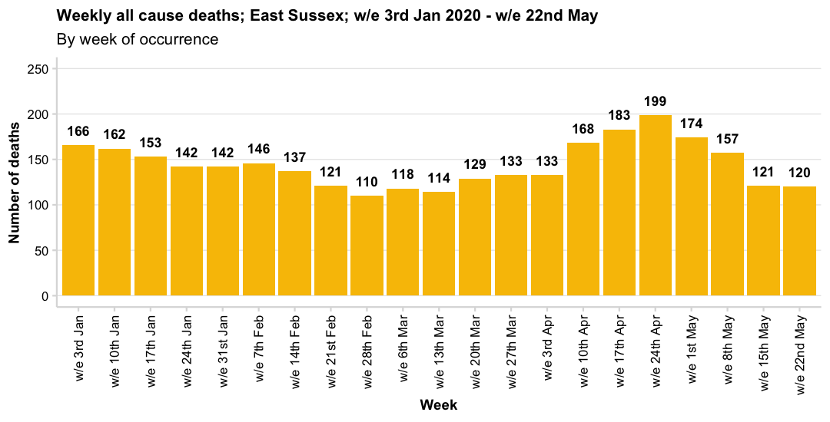
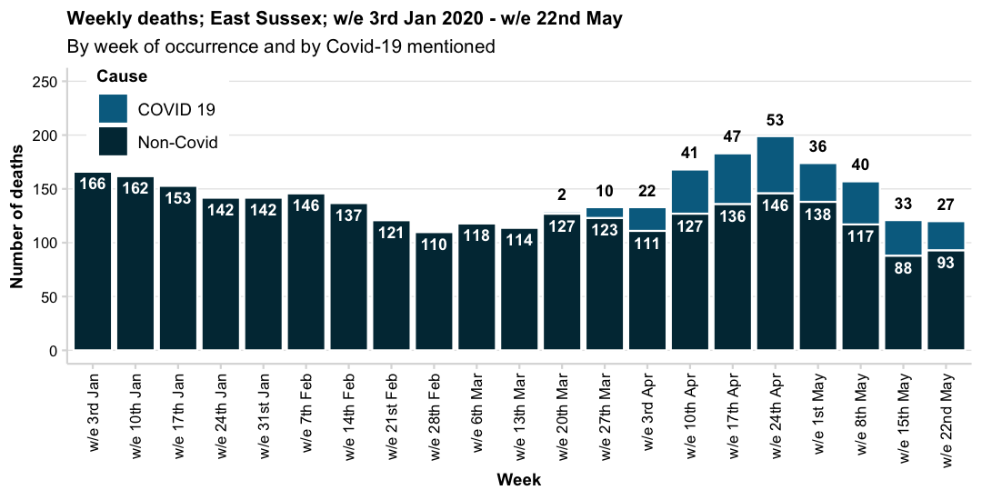
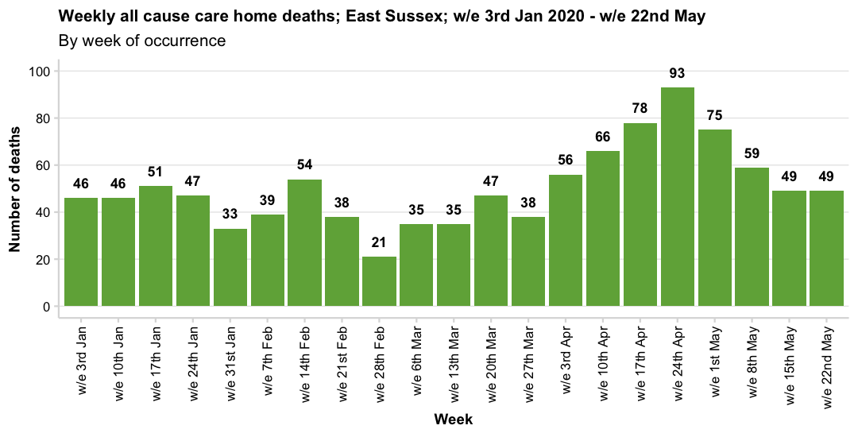
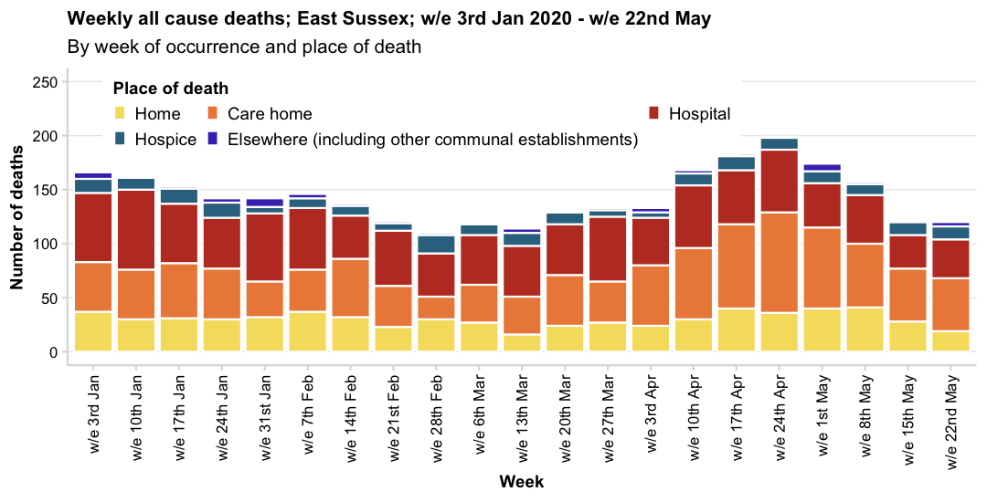
Source: Office for National Statistics

Slide 6
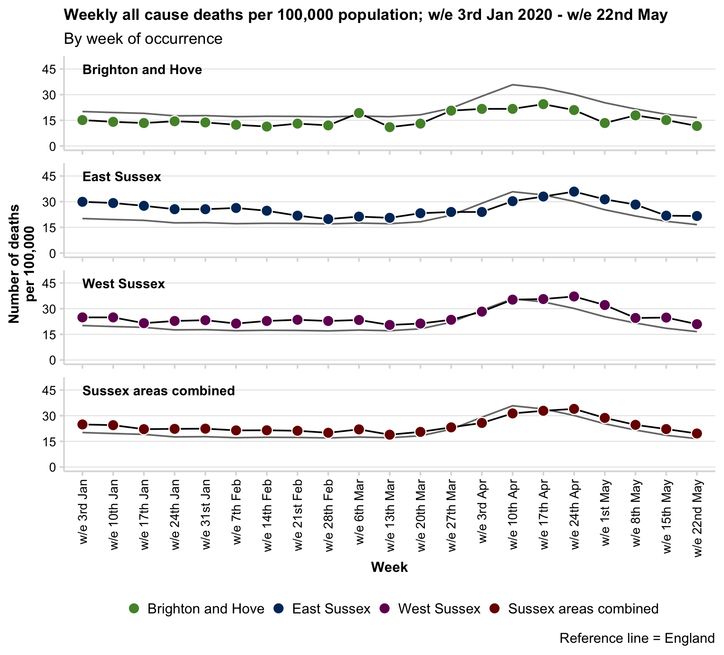
Crude rate of all cause mortality; to week ending 22/05/2020
A crude rate is calculated using the mid-2018 population estimates (all ages) for each area. Note that some areas in Sussex, particularly West Sussex, have an older population compared with England and so the rate is usually, and expectedly, above the national rate.
The crude rate of death has risen considerably nationally and locally.
This increase started towards the end of March but appears to be declining in some areas.
This graph shows the considerable increase at a national level, so that local and national crude rates are similar.
An age/sex standardised rates are not currently available for the weekly ONS release, although cumulative data for a shorter time period are presented later in this slide deck.

Slide 7
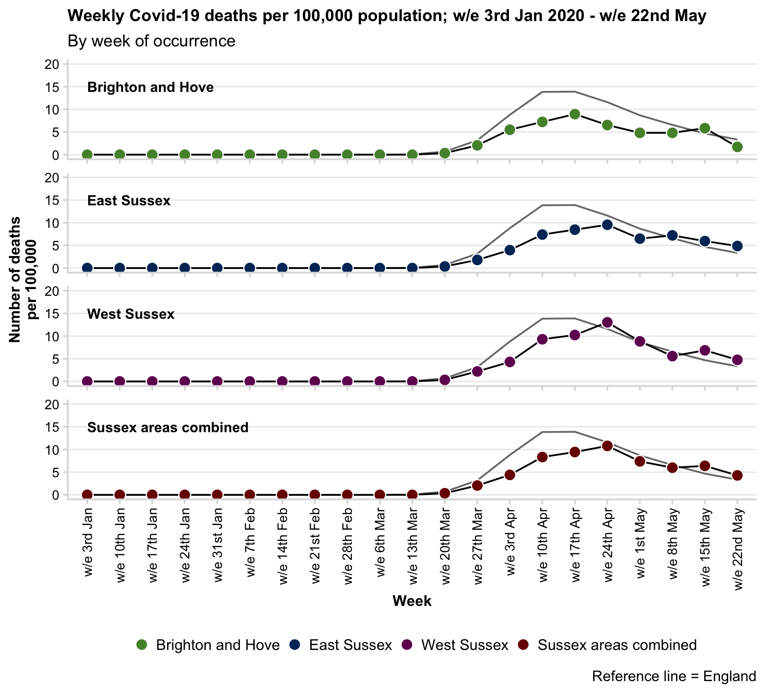
Crude rate of Covid-19 mortality; to week ending 22/05/2020
Crude rates of deaths where Covid-19 is mentioned as an underlying cause or contributing factor has risen locally.
In April the rate rose locally but was significantly lower than in England although rates are now statistically similar to national rates per 100,000 population.
The table below shows the change in deaths occurring in the last two weeks of reporting.
Note: the crude rate given in the table below is the cumulative total of Covid-19 deaths to date, and not the new deaths in the latest week.
Also note that deaths (particularly in the most recent week) may be revised if the were not registered by the 30th May.
Last two-week change Covid-19 mortality
Name | w/e 15th May | w/e 22nd May | Change (N) | Change (%) | Latest cumulative total | Latest cumulative rate per 100,000
Brighton and Hove | 17 | 5 | -12 | -70.60% | 139 | 47.9 (40.2-56.5)
East Sussex | 33 | 27 | -6 | -18.20% | 311 | 56.1 (50-62.7)
West Sussex | 59 | 41 | -18 | -30.50% | 563 | 65.6 (60.2-71.2)
Sussex areas combined | 109 | 73 | -36 | -33% | 1,013 | 59.5 (55.8-63.2)
England | 2,621 | 1,874 | -747 | -28.50% | 42,210 | 75.4 (74.7-76.1)

Slide 8
Areas are compared against their 15 statistical nearest neighbours. Ranks are therefore out of 16 with 1 being the highest and 16 being the lowest.
Statistical nearest neighbours are derived by The Chartered Institute of Public Finance and Accountancy (CIPFA) to group local authorities based on population characteristics, socioeconomic indicators, household and mortality characteristics.
Mortality summary tables; ONS death occurrence data; all deaths; week ending 22/05/2020
Name | All cause latest week summary | Covid-19 latest week summary | Proportion of deaths occurring in week that are attributed to Covid-19 | Rank of latest Covid-19 deaths crude rate among CIPFA neighbours | Total number of all cause deaths to date in 2020 | Rank of cumulative all cause deaths crude rate among CIPFA neighbours | Total number of deaths attributed to Covid-19 to date in 2020 | Rank of cumulative Covid-19 deaths crude rate among CIPFA neighbours | Proportion of deaths to date in 2020 attributed to Covid-19 | Rank of proportion of deaths to date attributed to Covid-19 among CIPFA neighbours
Brighton and Hove | 34 deaths (12 per 100,000, 95% CI: 8-16) | 5 deaths (2 per 100,000, 95% CI: 1-4) | 14.7% | 13th | 961 | 16th | 139 | 14th | 14.5% | 13th
East Sussex | 120 deaths (22 per 100,000, 95% CI: 18-26) | 27 deaths (5 per 100,000, 95% CI: 3-7) | 22.5% | 2nd | 3,028 | 1st | 311 | 13th | 10.3% | 13th
West Sussex | 180 deaths (21 per 100,000, 95% CI: 18-24) | 41 deaths (5 per 100,000, 95% CI: 3-6) | 22.8% | 4th | 4,599 | 2nd | 563 | 10th | 12.2% | 13th
Mortality summary tables; ONS death occurrence data; deaths in care homes; week ending 22/05/2020
Name | All cause latest week care home summary | Covid-19 latest week care home summary | Proportion of care home deaths occurring in week that are attributed to Covid-19 | Rank of latest Covid-19 care home deaths crude rate among CIPFA neighbours per 1,000 care home beds | Total number of all cause care home deaths to date in 2020 | Total number of care home deaths attributed to Covid-19 to date in 2020 | Proportion of care home deaths to date in 2020 attributed to Covid-19 | Rank of cumulative all cause care home deaths crude rate among CIPFA neighbours | Rank of cumulative Covid-19 care home deaths crude rate among CIPFA neighbours per 1,000 care home beds | Rank of proportion of care home deaths to date attributed to Covid-19 among CIPFA neighbours
Brighton and Hove | 7 deaths (3 per 1,000 care home beds, 95% CI: 1-7) | 2 deaths (1 per 1,000 care home beds, 95% CI: 0-3) | 28.6% | 14th | 278 | 52 | 18.7% | 15th | 13th | 10th
East Sussex | 49 deaths (6 per 1,000 care home beds, 95% CI: 4-8) | 19 deaths (2 per 1,000 care home beds, 95% CI: 1-4) | 38.8% | 4th | 1,055 | 139 | 13.2% | 16th | 11th | 10th
West Sussex | 74 deaths (7 per 1,000 care home beds, 95% CI: 6-9) | 23 deaths (2 per 1,000 care home beds, 95% CI: 1-3) | 31.1% | 6th | 1,640 | 262 | 16.0% | 8th | 7th | 6th

Slide 9
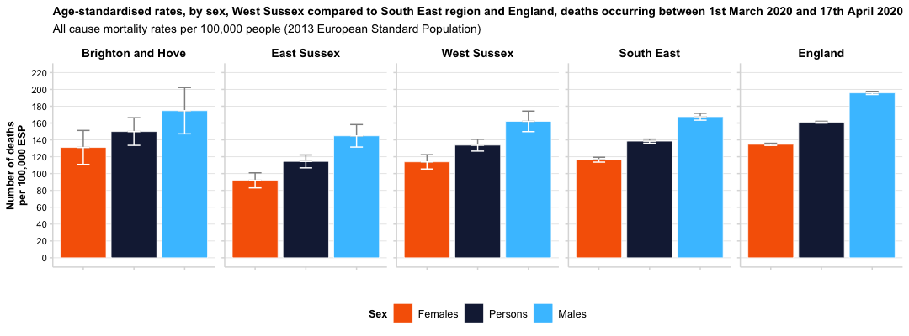
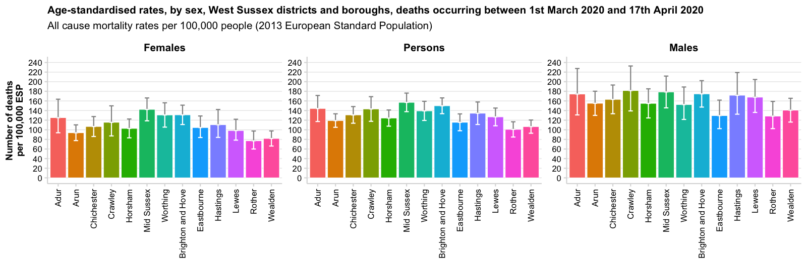
All cause mortality; persons; occurring 01/03/2020 – 17/04/2020
Name | All cause deaths | Age-standardised rate per 100,000
Brighton and Hove | 329 | 150 per 100,000 ESP, 95% CI: 134-166
East Sussex | 889 | 114 per 100,000 ESP, 95% CI: 107-122
Eastbourne | 177 | 116 per 100,000 ESP, 95% CI: 98-133
Hastings | 129 | 134 per 100,000 ESP, 95% CI: 111-158
Lewes | 186 | 127 per 100,000 ESP, 95% CI: 108-145
Rother | 163 | 101 per 100,000 ESP, 95% CI: 85-117
Wealden | 234 | 107 per 100,000 ESP, 95% CI: 93-120
West Sussex | 1,409 | 134 per 100,000 ESP, 95% CI: 127-141
Adur | 110 | 144 per 100,000 ESP, 95% CI: 117-171
Arun | 285 | 119 per 100,000 ESP, 95% CI: 105-133
Chichester | 227 | 131 per 100,000 ESP, 95% CI: 114-148
Crawley | 123 | 143 per 100,000 ESP, 95% CI: 118-169
Horsham | 212 | 124 per 100,000 ESP, 95% CI: 108-141
Mid Sussex | 258 | 157 per 100,000 ESP, 95% CI: 138-176
Worthing | 194 | 139 per 100,000 ESP, 95% CI: 119-159
South East | 13,024 | 138 per 100,000 ESP, 95% CI: 136-141
England | 84,908 | 161 per 100,000 ESP, 95% CI: 160-162
Differences in age-standardised rates of all cause mortality are generally only statistically significant at upper tier Local Authority level, with men consistently having a higher age-standardised mortality rate than women in East and West Sussex, but not in Brighton and Hove.

Slide 10
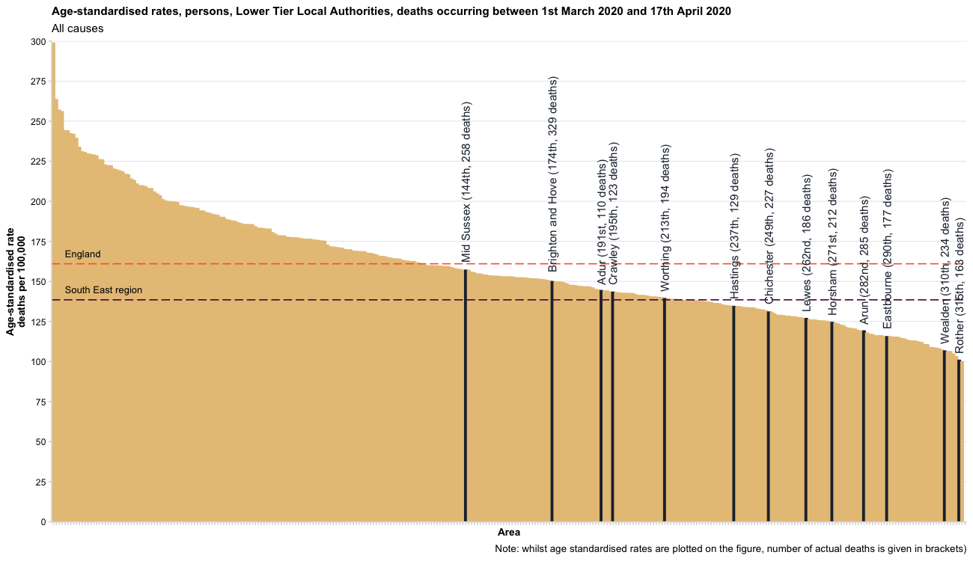
All cause mortality; occurring 01/03/2020 – 17/04/2020
Areas are ranked from highest to lowest age-standardised mortality rate out of 317 lower tier local authority areas (2019 boundaries).

Slide 11
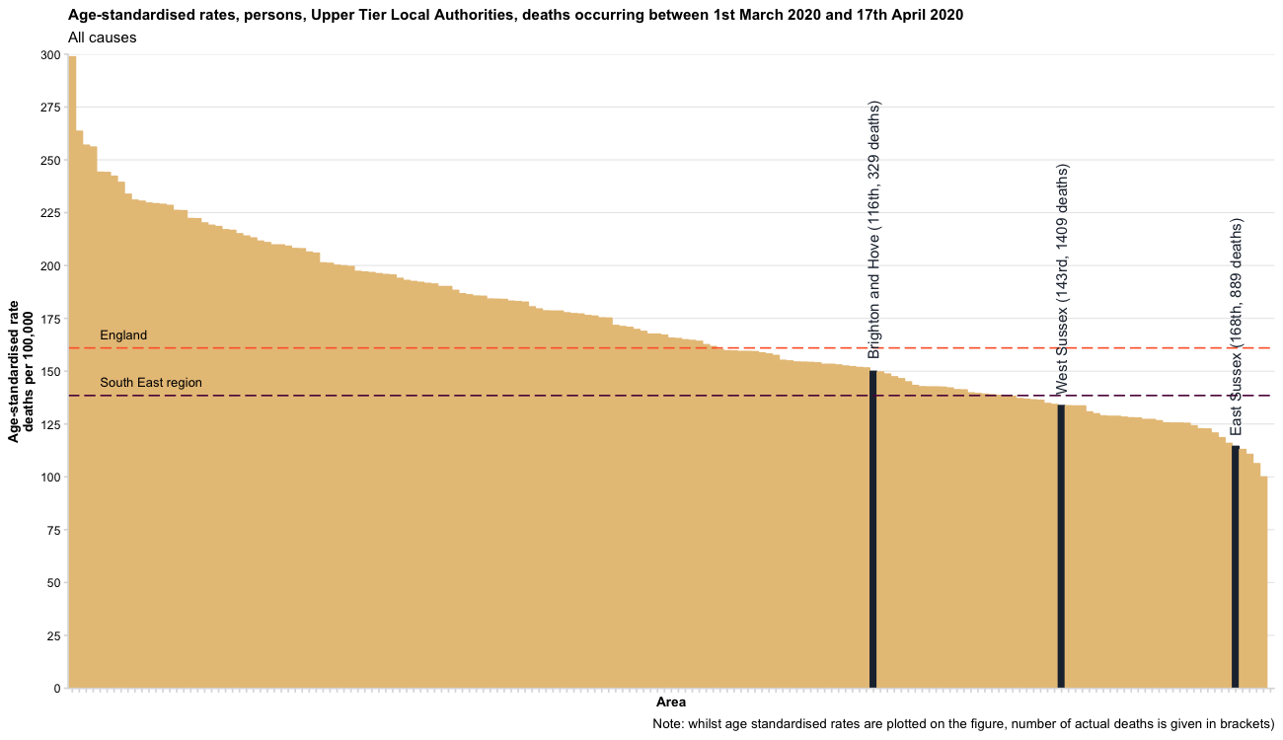
All cause mortality; occurring 01/03/2020 – 17/04/2020
Areas are ranked from highest to lowest age-standardised mortality rate out of 173 upper tier local authority areas (2019 boundaries).

Slide 12
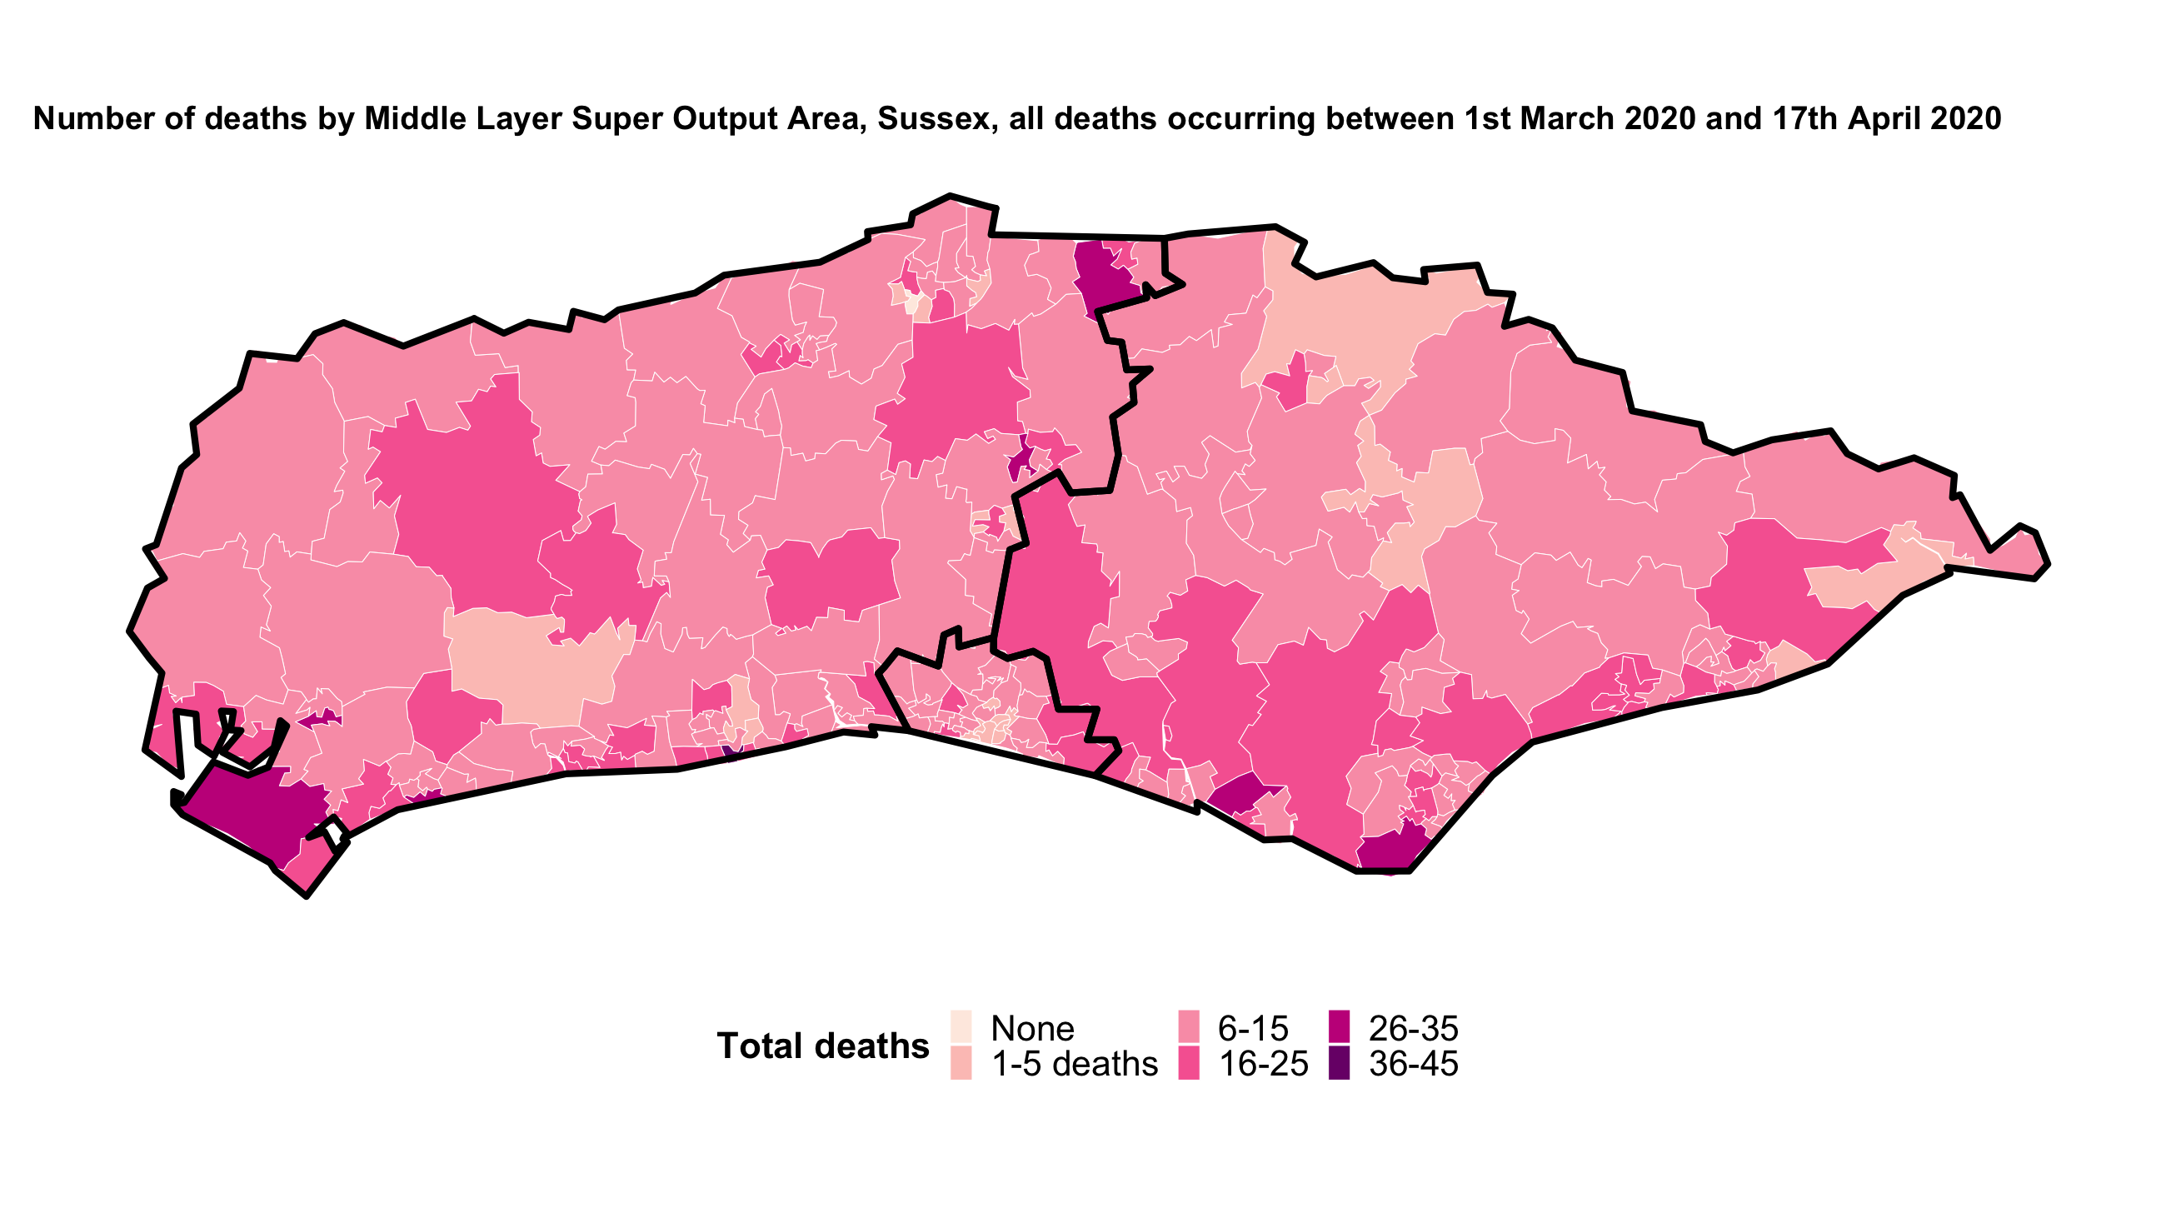
All cause mortality; occurring 01/03/2020 – 17/04/2020

Slide 13
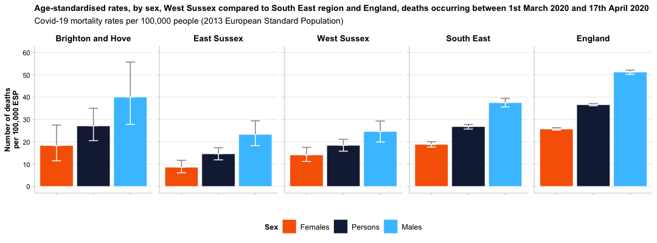
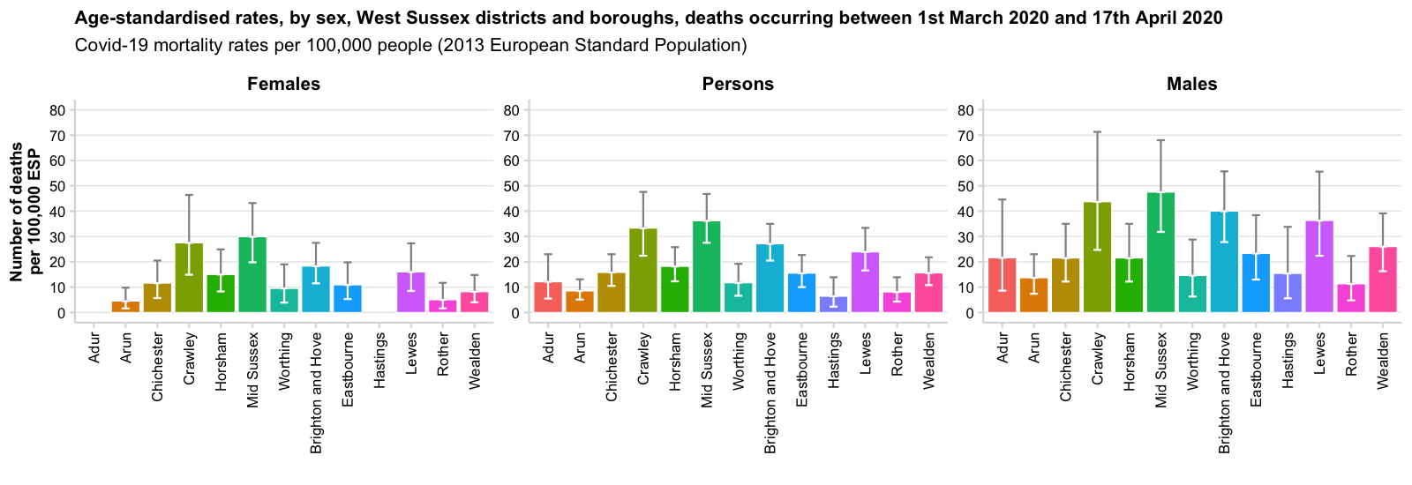
Covid-19 mortality; persons; occurring 01/03/2020 – 17/04/2020
Name | Covid-19 deaths | Age-standardised rate per 100,000
Brighton and Hove | 59 | 27 per 100,000 ESP, 95% CI: 20-35
East Sussex | 114 | 15 per 100,000 ESP, 95% CI: 12-17
Eastbourne | 26 | 16 per 100,000 ESP, 95% CI: 10-23
Hastings | 6 | 6 per 100,000 ESP, 95% CI: 2-14
Lewes | 35 | 24 per 100,000 ESP, 95% CI: 17-33
Rother | 13 | 8 per 100,000 ESP, 95% CI: 4-14
Wealden | 34 | 16 per 100,000 ESP, 95% CI: 11-22
West Sussex | 193 | 18 per 100,000 ESP, 95% CI: 16-21
Adur | 9 | 12 per 100,000 ESP, 95% CI: 6-23
Arun | 20 | 8 per 100,000 ESP, 95% CI: 5-13
Chichester | 28 | 16 per 100,000 ESP, 95% CI: 10-23
Crawley | 30 | 33 per 100,000 ESP, 95% CI: 22-48
Horsham | 31 | 18 per 100,000 ESP, 95% CI: 12-26
Mid Sussex | 59 | 36 per 100,000 ESP, 95% CI: 28-47
Worthing | 16 | 12 per 100,000 ESP, 95% CI: 7-19
South East | 2,508 | 27 per 100,000 ESP, 95% CI: 26-28
England | 19,315 | 37 per 100,000 ESP, 95% CI: 36-37
Age-standardised rates of Covid-19 mortality are higher among men compared with women.
Although numbers are small, there are some clear differences at lower tier local authority level, with Crawley, Mid Sussex, Brighton and Hove and Lewes having significantly higher rates of mortality compared with other areas.

Slide 14
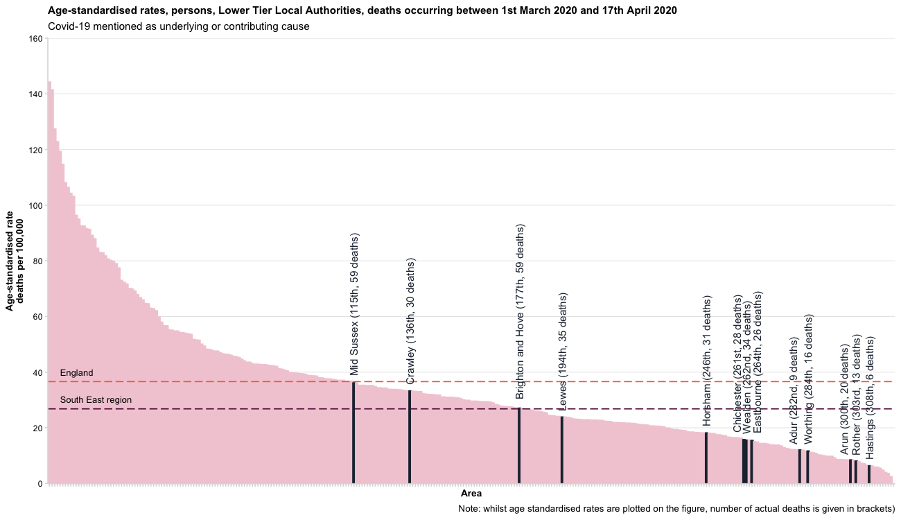
Covid-19 mortality; occurring 01/03/2020 – 17/04/2020
Areas are ranked from highest to lowest age-standardised mortality rate out of 317 lower tier local authority areas (2019 boundaries).

Slide 15
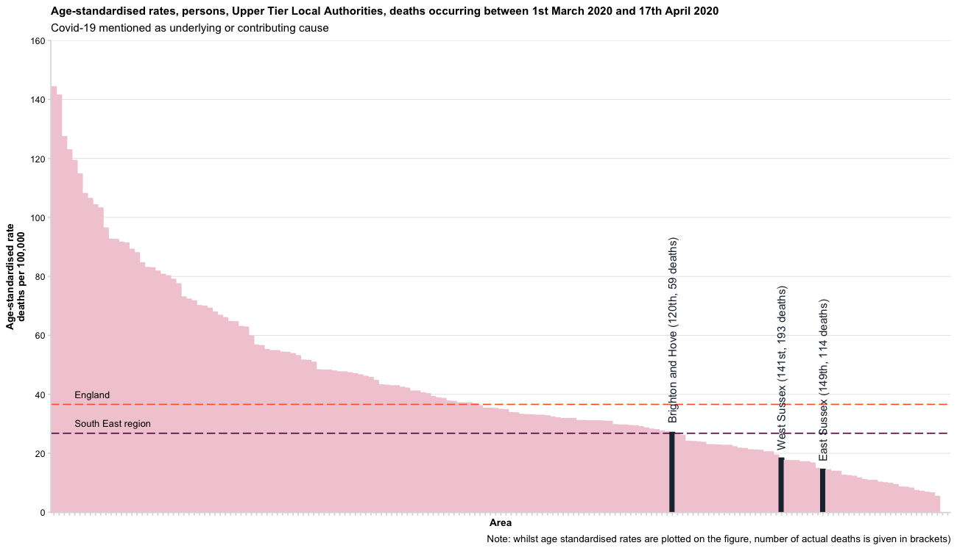
Covid-19 mortality; occurring 01/03/2020 – 17/04/2020
Areas are ranked from highest to lowest age-standardised mortality rate out of 173 upper tier local authority areas (2019 boundaries).

Slide 16
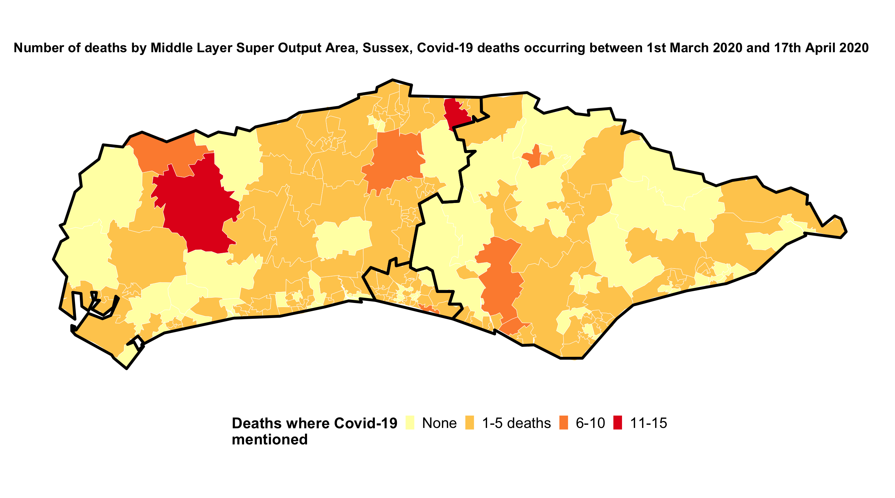
Covid-19 mortality; occurring 01/03/2020 – 17/04/2020

Slide 17
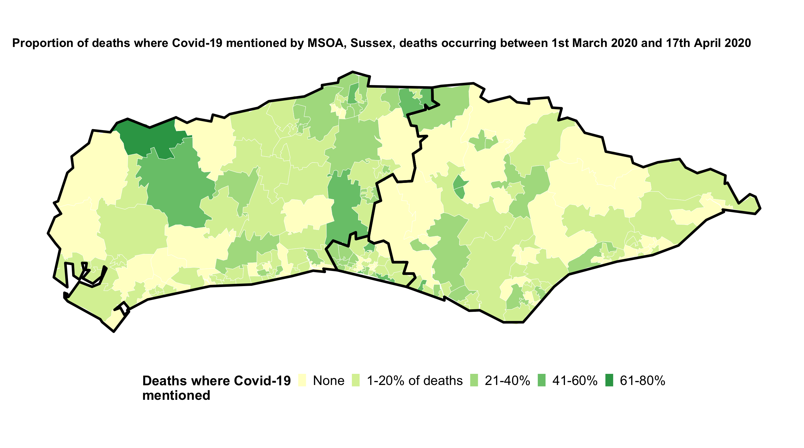
Covid-19 mortality; occurring 01/03/2020 – 17/04/2020

Slide 18
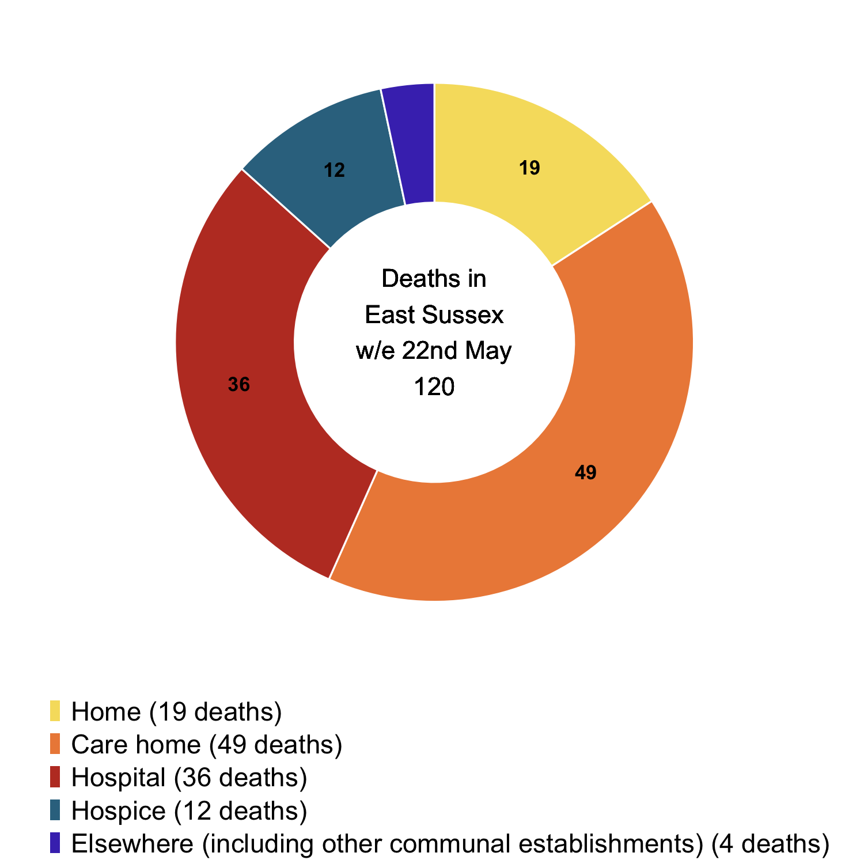
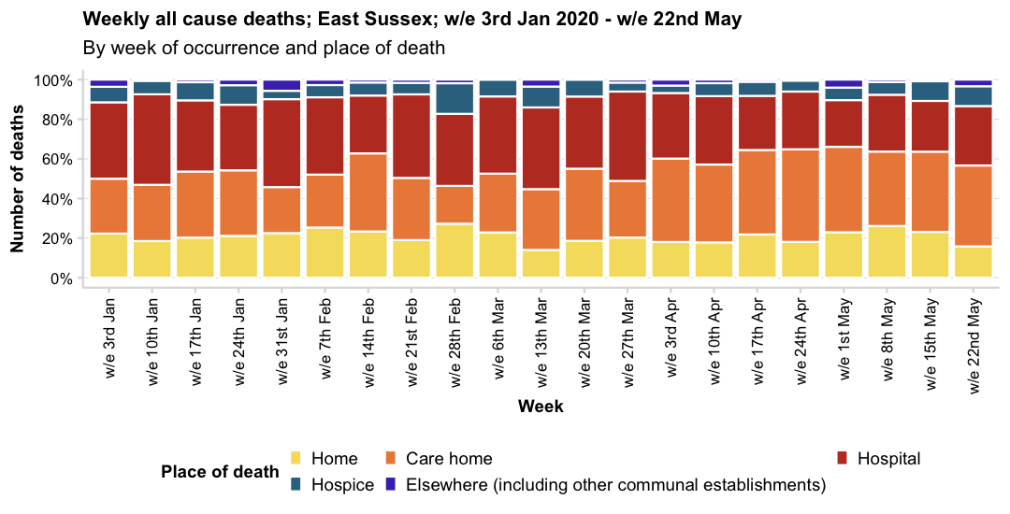
In East Sussex, in the week ending 29th May, the proportion of deaths in care homes has slightly increased, following declines at the end of April.
The total number of deaths this week were similar to the previous week (120 compared to 121), although figures may be revised as registrations are added.
The proportion of deaths at home decreased whilst deaths in hospital rose to 30%.
All cause mortality; East Sussex; week ending 29th May
Place of death | w/e 3rd Jan | w/e 10th Jan | w/e 17th Jan | w/e 24th Jan | w/e 31st Jan | w/e 7th Feb | w/e 14th Feb | w/e 21st Feb | w/e 28th Feb | w/e 6th Mar | w/e 13th Mar | w/e 20th Mar | w/e 27th Mar | w/e 3rd Apr | w/e 10th Apr | w/e 17th Apr | w/e 24th Apr | w/e 1st May | w/e 8th May | w/e 15th May | w/e 22nd May | w/e 29th May
Home
Care home
Hospital
Hospice
Elsewhere

Slide 19
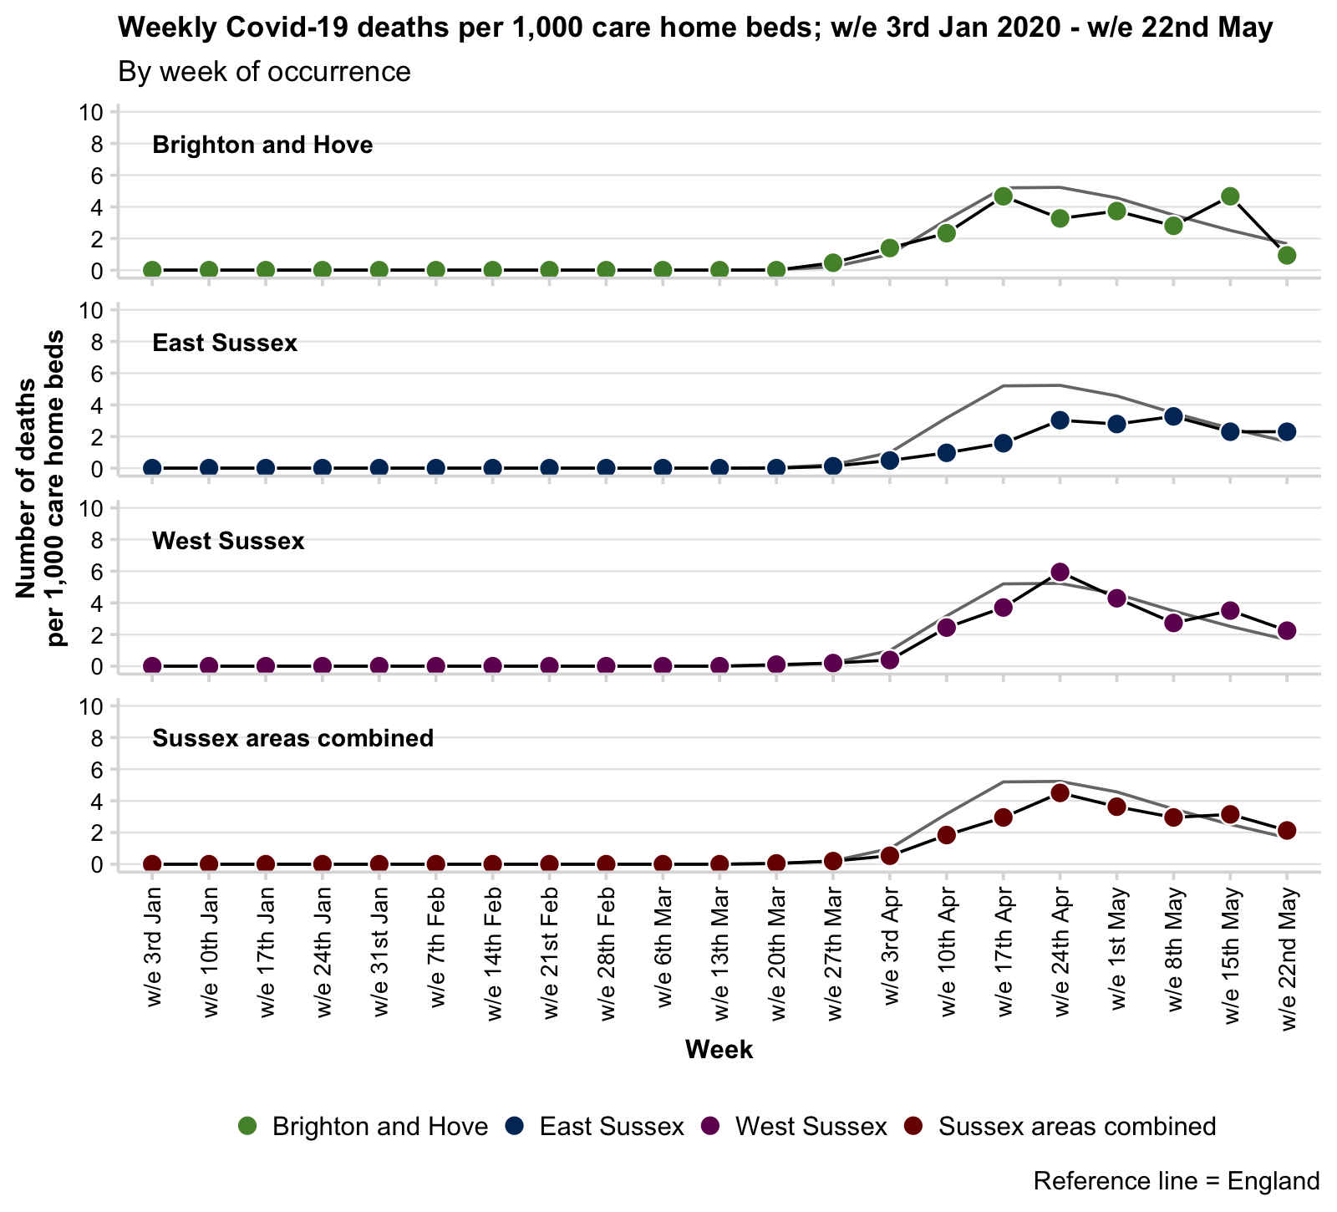
Crude rate of Covid-19 mortality in Care Homes; to week ending 22/05/2020
Crude rates of deaths where Covid-19 is mentioned as an underlying cause or contributing factor has risen locally.
The denominator is the number of beds in care homes (all; nursing and residential) in each area as reported by Care Quality Care (CQC) on the 31st of March 2019. The rate of Covid-19 deaths is given per 1,000 care home beds.
The table below shows the change in deaths occurring in the last two weeks of reporting.
Note: the crude rate given in the table below is the cumulative total of Covid-19 deaths to date, and not the new deaths in the latest week.
Also note that deaths (particularly in the most recent week) may be revised if the were not registered by the 30th May.
Last two-week change Covid-19 mortality in care homes
Name | w/e 15th May | w/e 22nd May | Change (N) | Change (%) | Latest cumulative total | Latest cumulative rate per 1,000 beds
Brighton and Hove | 10 | 2 | -8 | -80% | 52 | 24.3 (18.1-31.8)
East Sussex | 19 | 19 | 0 | 0% | 139 | 16.8 (14.2-19.9)
West Sussex | 36 | 23 | -13 | -36.10% | 262 | 25.5 (22.5-28.8)
Sussex areas combined | 65 | 44 | -21 | -32.30% | 453 | 21.9 (20-24)
England | 1,146 | 762 | -384 | -33.50% | 12,346 | 27.1 (26.6-27.6)

Slide 20
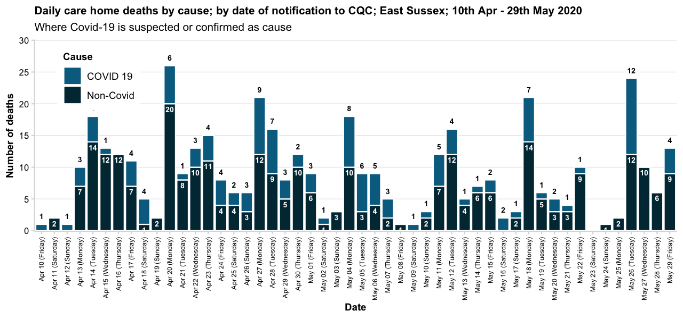
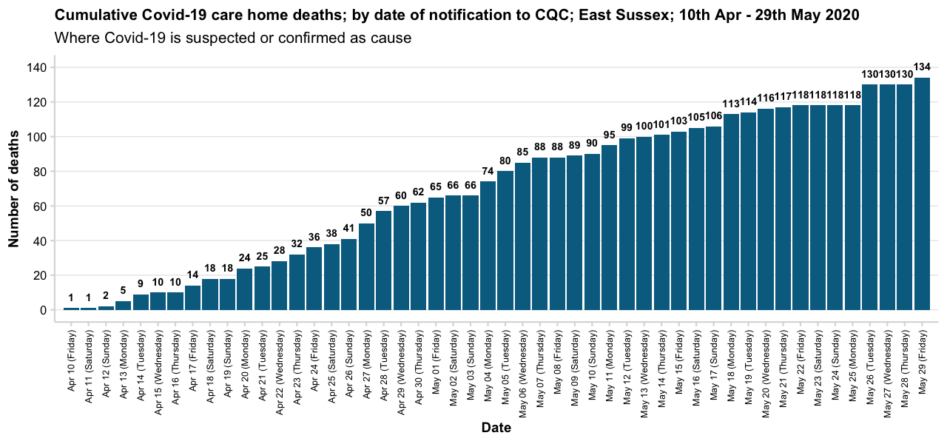
Daily care home deaths notified to the Care Quality Commission; East Sussex 05/06/2020
The processes for registering deaths naturally take time and so the Care Quality Commission, have begun reporting the number of deaths they have been notified as soon as it is practicably possible to support the response to Covid-19.
Death notifications by date of notification are provided weekly at the same time as the ONS release. Death notifications take on average 4 days to receive and process. These are not officially registered deaths and can be subject to revision and verification. Data are for April 10th onwards.
Note: Notifications only include those received by 5pm on 5th June.
As at 29th May there have been 134 Covid-19 deaths notified to Care Quality Commission from East Sussex care homes.
This is 31.2% of the 430 deaths notified to CQC between 10th April and 29th May.

Slide 21
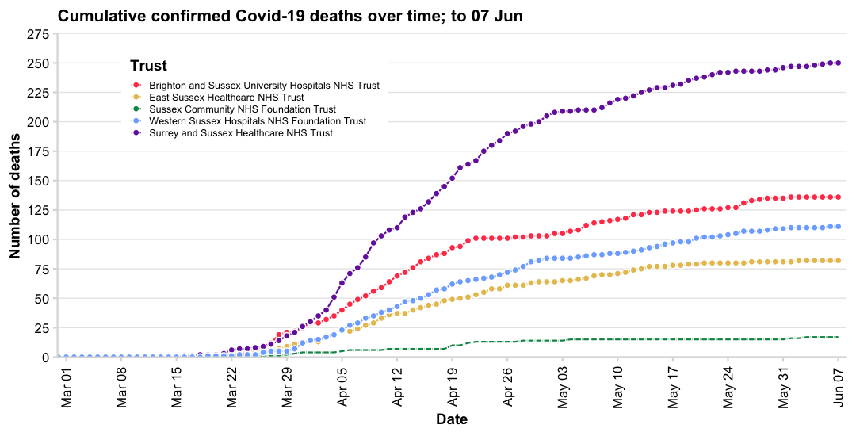
Daily hospital deaths notified to Department for Health and Social Care; up to 07/06/2020
This is the number of deaths of patients who have died in hospitals in England and had tested positive for Covid-19 at time of death. All deaths are recorded against the date of death rather than the day the deaths were announced.
These figures are updated at 2pm each day and include confirmed death cases reported at 5pm the previous day. The totals reported at 5pm on each day may not include all deaths that occurred on that day or on recent prior days due to operational pressures.
Data are provided daily by NHS Trusts and PHE Health protection teams to NHS England and only once confirmed family have been notified of the death.
Daily hospital deaths notified to Department for Health and Social Care; last 14 days to 07/06/2020
Trust | 25th May 2020 | 26th May 2020 | 27th May 2020 | 28th May 2020 | 29th May 2020 | 30th May 2020 | 31st May 2020 | 1st June 2020 | 2nd June 2020 | 3rd June 2020 | 4th June 2020 | 5th June 2020 | 6th June 2020 | 7th June 2020 | Total deaths reported in Trust so far | Crude rate deaths per 100,000 emergency catchment population
Brighton and Sussex University Hospitals NHS Trust | 0 | 4 | 2 | 1 | 1 | 0 | 0 | 1 | 0 | 0 | 0 | 0 | 0 | 0 | 136 | 25.4 per 100,000 (21.3-30)
East Sussex Healthcare NHS Trust | 0 | 0 | 1 | 0 | 0 | 0 | 0 | 0 | 1 | 0 | 0 | 0 | 0 | 0 | 82 | 22.5 per 100,000 (17.9-27.9)
Surrey and Sussex Healthcare NHS Trust | 1 | 0 | 0 | 0 | 1 | 0 | 2 | 1 | 0 | 0 | 1 | 1 | 1 | 0 | 250 | 65.4 per 100,000 (57.5-74)
Sussex Community NHS Foundation Trust | 0 | 0 | 0 | 0 | 0 | 0 | 0 | 1 | 0 | 1 | 0 | 0 | 0 | 0 | 17 | -
Western Sussex Hospitals NHS Foundation Trust | 1 | 2 | 0 | 0 | 1 | 1 | 0 | 1 | 0 | 0 | 0 | 0 | 1 | 0 | 111 | 23.3 per 100,000 (19.1-28)
England | 131 | 135 | 115 | 118 | 106 | 89 | 77 | 89 | 97 | 93 | 64 | 54 | 43 | 10 | 27,489 | -
These five days should be treated
as incomplete.

